Slide 1
American Literature
Week 10
October 8th -12th

Slide 2
Monday-October 8th
Quick Write: Imagine you are a witness to a situation you perceive as unjust. What is your response? Do you speak out or remain silent?
In a brief journal, describe how you would respond to injustice. If you have experienced a real situation, you can write about how you really responded or how you wish you responded.
Finish Revisions Chart for Definition Essay(10-15 minutes)
-Your chart should have your grade on the revision quiz written on the top
-Please turn in your essay and corrections chart
-Keep your notes in your folder
-You will need to come during AO on Tuesday if you need extra time.
Finished with your corrections? You can log onto www.vocabulary.com to preview the next unit (The Crucible-vocabulary from all 4 Acts).
-Practice due 10/24 at 8 AM; Assessment on 10/24

Slide 3
Salem Witch Trials-The History Channel
Complete the viewing guide as we learn more about the historical figures/time period that Arthur Miller used for his play The Crucible.
Information from the video will be included on the test.
HW: Finish revisions during AO
Vocabulary due 10/24 at 8 AM-assessment on 10/24

Slide 4
Tuesday-October 9th
Greyhound News: www.GreyhoundNews.net
Finish watching The Salem Witch Trials-History Channel
Quick Write: Please use the same piece of paper as yesterday. Date each entry to help keep track of them. We will complete 5 total before you turn them in☺

Slide 5
Quick Write-October 9th
Quick Write: The narrator states at the end of the video, that the this would not be the last time America was caught up in a witch hunt wherein one group was vilified and persecuted to allay the fears of another group. He also says that, moving forward, Americans would always assume one was innocent until proven guilty. Make connections to contemporary culture. Consider what we fear in contemporary culture? Does our social atmosphere make us vulnerable to “witch hunts” or do we have balances in place to prevent them? Consider the impact of media on fear and justice.
This should be at least ½ page.

Slide 6
Wednesday(10th) and Thursday(11th)
Greyhound News: www.GreyhoundNews.net (1st period on Thursday only!)
Discuss quick write from after the Salem Witch Trial Video.

Slide 7
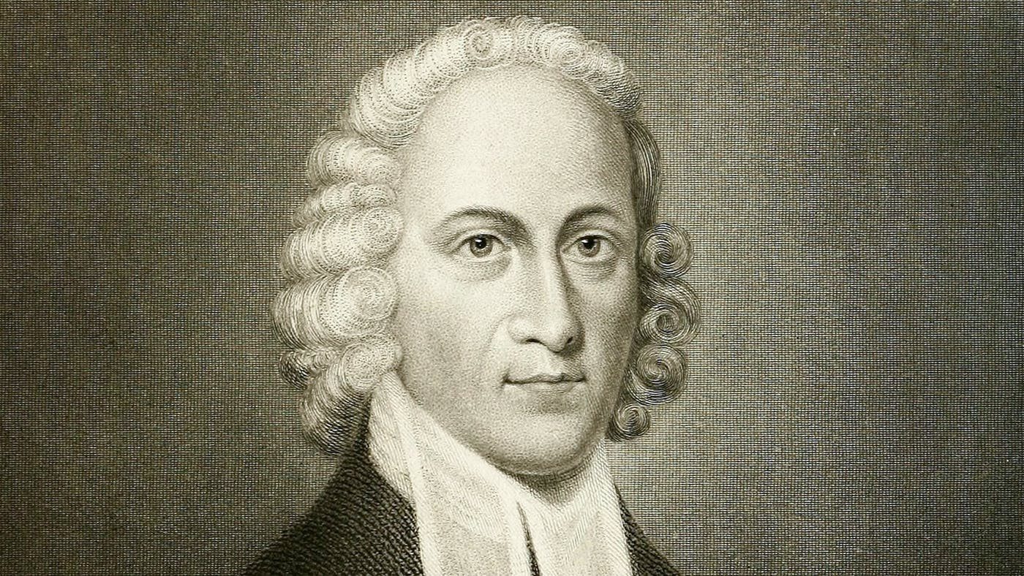
“Sinners in the Hands of an Angry God”
Jonathan Edwards (1703-1758)
Ordained minister at 23
prominent leader in the Great Awakening, a movement to reconnect Christians with their faith on a personal level
“Sinners in the Hands of an Angry God” was delivered in 1741 (nearly 50 years after the Salem witch trials)
Reflects the Puritan concepts and ideals of the time.

Slide 8
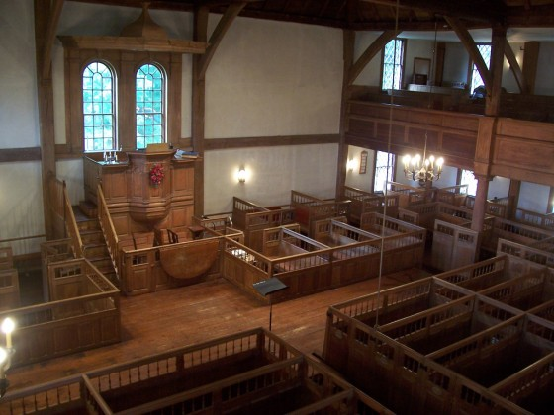
Puritan Churches & Services
Building was very plain; response to Roman Catholic churches
No air conditioning
Mandatory; subject to fine if you didn’t attend
Highlight of the week for the community
Services could be 3+ hours
A large hourglass was used for preacher to track time

Slide 9
Puritan Churches & Services
One pastor who knew that people sometimes left during the sermon said he would preach the first half of the sermon to sinners and the second to the saints. People could leave when their part ended.
Average sermon today ranges from 15-35 minutes

Slide 10
“Sinners in the Hands of an Angry God”
Quick Write: Jonathan Edwards, an famous Puritan preacher/writer, described God as one who “holds you over the pit of hell, much as one holds a spider, or some loathsome insect over the Fire.” What does this quotation tell us about the Puritans’ relationship with their God? How would you feel if this were preached to you?
Listen to A Little More About Edwards
“Sinners in the Hands of an Angry God”
Complete graphic organizer while you listen-pay attention to imagery

Slide 11
Friday-October 12th
Red Scare/McCarthyism Webquest
Keep phone
Pick up webquest handout
Have something hard to write on, pen, and headphones
Leave your stuff here

