Slide 1
American Literature Week 3
August 13th-17th

Slide 2
Monday-August 13th
Please put your completed vision board on your desk. Make sure you have your name on it. Explanation of items should be on back or attached. Do not turn it in without explanation!
20 minutes: Work on your poem or dialogue from Friday as I collect vision boards. Be prepared to share your writing in a small group at the end of this work time.
Do not freak out! The final draft is due tomorrow☺

Slide 3
Step 1: Trade poem/dialogue with a partner who chose the same prompt.
Step 2: Read poem/dialogue and answer the following questions on the bottom or back of their rough draft. Please write your name near your responses. DO NOT WRITE OVER THEIR WORK OR CORRECT IT. JUST ANSWER THE QUESTIONS!
Choice #1-Whitman style poem List the groups celebrated. Identify the tone(adjective). List the words that indicate tone. List any words that activate your senses(imagery). | Choice #2-Hughes style poem Identify the subgroup that the speaker represents. Identify the tone(adjective). List the words that indicate tone List any words that activate your senses(imagery). | Choice #3-Dialogue List the points of agreement List points of disagreement How did your partner have Whitman respond to Hughes’s poem?

Slide 4
Step 3: Find another pair who also chose your prompt. Choose the best version from your group and be prepared to share with the class. The person who wrote it does not have to read it! You can read for a classmate if they are shy but have the best work!
Step 4: Return to seat to edit your work. If your partner could not identify necessary elements, add them in. Make sure your tone is clear and that you included imagery.
Homework:
Final draft of We Sing America assignment due tomorrow-BLUE/BLACK INK or TYPED-please attach your rough draft with partner’s comments to the final.
ARITS vocab practice due Thursday @ 8:00 AM
ARITS vocab assessment on Friday
Unit 1 test on Thursday, August 23rd(includes ARITS)

Slide 5
Tuesday-August 14th
DO NOW
Draw the table below in your notebook
Sort your ARITS vocabulary list according to connotation (positive/neutral/negative).
CONNOTATION: an idea or feeling that a word invokes in addition to its literal or primary meaning
**Please put your final draft and rough draft of your poem on your desk. I will collect!
Positive | Neutral | Negative
 |  | furtive
furtive | erratic | falter | bastion | defer | precarious | sullen
rebuff | fester | shrewd | stead | resignation | idle | undaunted
implore | acute | gait | evade | permeate | rousing

Slide 6
Check your sort! How many words did you place correctly?
Vocabulary is due on Thursday at 8 AM! Study for the quiz on Friday.
Positive | Neutral | Negative
bastion, undaunted, rousing, shrewd | Defer, stead, implore, acute, gait, permeate | furtive, erratic, falter, precarious, sullen, rebuff, fester, resignation, idle, evade

Slide 7
Poetry Term Review(take notes for unfamiliar terms)
1. Rhyme
Repetition of sounds at the ends of words
2. Meter
Pattern or stressed and unstressed syllables in poetry
3. Imagery
Descriptive language used to create word pictures; words and details that appeal to 1 or more of the 5 senses

Slide 8
Poetry Term Review
4. Diction
Writer’s choice of words; helps convey voice and tone
5. Anaphora
Repetition of the same word or group of words at the beginnings of two or more clauses or lines
6. Repetition
Use of any element of language(sound, word, phrase, line or stanza) more than once

Slide 9
Poetry Term Review
7. Catalog poem
A poem that uses repetition and variation in the creation of a list, or catalog, of objects or desires, plans, or memories
8. Parallel Structure
Grammatical or structural similarity between sentences or parts of a sentence, so that elements of equal importance are equally developed and similarly phrased for emphasis
9. Vernacular
the language or dialect spoken by the ordinary people in a particular country or region

Slide 10
Poetry Term Review
10. Figurative Language
Imaginative language or figures of speech not meant to be taken literally(metaphor, simile, hyperbole, etc.)
11. Personification
Figure of speech used to describe something as having human qualities
12. Rhetorical Question
A question that is asked for effect or one for which the answer is obvious
13. Allusion
A reference made to a well-known person, event, or place from history, music, art, or another literary work

Slide 11
American Dream Poems
Read blue packet of American Dream poems.
Analyze and discuss four of the of the seven poems with a partner.
Complete the Dream Poetry chart to identify the tone and any poetic devices used by the author.
Please cite text to support your answers(include quotations from poem).
HW:
ARITS vocab practice due Thursday @ 8:00 AM
ARITS vocab assessment on Friday
Unit 1 test on Thursday, August 23rd(includes ARITS)

Slide 12
Wednesday
DO NOW- Finish analyzing the 4 poems you selected on the chart from yesterday.
Things to remember
Have The Great Gatsby by 8/20. Copies may be in media center or public library if you act fast. If you have a financial need, let me know discreetly ASAP so I can get one for you.
Vocabulary.com assignment due tomorrow at 8 AM(no exceptions)
Vocabulary assessment on Friday
Picture day during class on Tuesday
Unit 1 assessment on August 23rd(next Thursday)

Slide 13
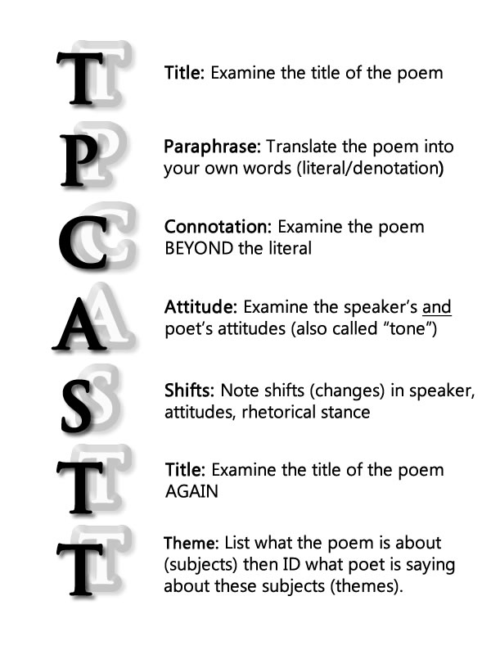
Wednesday
TPCASTT

Slide 14
Wednesday: Use your notes from the chart to complete the TPCASTT assignment on your own.
If you are not finished, please complete for homework.
Link to poems: https://docs.google.com/document/d/1r98N442NrjlYq-xqIFqkht1uqVTm_T3ylATh_omf5js/edit?usp=sharing

Slide 15
Thursday-August 16th
DO NOW!-Checking Your Understanding
1. What technique did John McCain use in defining “patriotism” in his essay?
2. How was Walt Whitman different than poets that came before him?
3. What is a catalog? (in literature)
4. What is free verse?
5. Why was Langston Hughes important - what did he write about?
6. How are the styles of Whitman and Hughes similar or different? Think about literary tools they use.

Slide 16
Thursday-August 16th
SB 1.5 – Read “America and I” p.19-USE A PEN, PLEASE!
Underline words and phrases that show the tone of the narrator’s attitude toward America
Put a star next to the lines that include imagery
Answer 1-6 on p. 27
HW: Finish questions on p. 27
Study for vocabulary assessment!

Slide 17
FRIDAY-Modifiers
One of comedian Groucho Marx's most famous jokes involves a pachyderm and some sleepwear.
"One morning I shot an elephant in my pajamas," he says. "How he got in my pajamas I don't know!“
This joke is a play on a grammatical error called a misplaced modifier, where a descriptive phrase or word is placed in the wrong part of the sentence.
Key Principal: Modifiers must be next to what they modify.
Misplaced- The modifier and what it modifies aren’t close together.
Dangling- What they modify isn’t in the sentence.
Squinting - between two things not obvious to which it is referring
https://www.youtube.com/watch?v=-tX34V_XGeQ

Slide 18
Friday
Vocab quiz-Take your time and cover your answers!
Complete modifier practice on pages 12 & 13 when done.
1. What technique did John McCain use in defining “patriotism” in his essay? 2. How was Walt Whitman different than poets who came before him? 3. What is a catalog? (in literature) 4. What is free verse? 5. Why was Langston Hughes important? What did he write about? 6. How are the styles of Whitman and Hughes similar or different? Think about literary tools they use.

Slide 19
1. Exemplification 2. He used common language, a unique structure and chose “common man” themes 3. A poem with a repeating phrase at the beginning that lists like objects, places, people 4. Poetry that does not rhyme or have a regular meter 5. Langston Hughes was one of the leaders of the Harlem Renaissance. He wrote about the black experience in America. 6. Both use free verse, uses common speech patterns. Whitman celebrates the country’s working class and cultural diversity. He also using cataloguing as his structure. Hughes reveals America’s flaws, but remains optimistic.

