Slide 1
American Literature Week 8
September 17th-21st

Slide 2
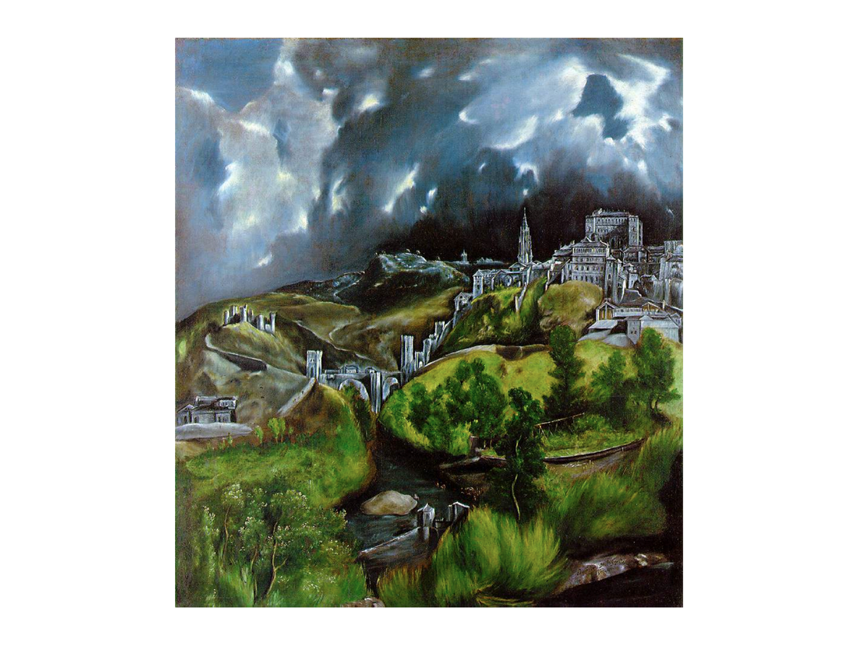
Monday
Chapter 9 Reading Check
Review Chapter 9 questions
Who’s to blame?-Test Review
Crash Course: Great Gatsby Part I
Crash Course: Great Gatsby Part II
HW: The Great Gatsby Test on 9/18(TOMORROW!)
Vocabulary practice(chapters 6 and 7) due 9/20 at 8:00 AM
QUIZ SAME DAY!

Slide 3
Tuesday-September 18th
Greyhound News: www.GreyhoundNews.net
The Great Gatsby Test
When you are finished, complete vocabulary connotation sort.
9/20 - Vocab Practice due by 8 AM 9/20 - Vocab Test

Slide 4
Wednesday-September 19th
Watch The Great Gatsby (How is the text different/same as the film?)
9/20 - Vocab Practice due by 8 AM 9/20 - Vocab assessment

Slide 5
Thursday-September 20th
Greyhound News: www.GreyhoundNews.net
Vocabulary Assessment: 25 minute limit
Continue watching The Great Gatsby (How is the text different/same as the film?)

Slide 6
Friday-September 21st
Continue watching The Great Gatsby (How is the text different/same as the film?)
HW: Be safe over the break☺

