Slide 1
American Literature
Week 9
October 1st-5th

Slide 2
Monday-October 1st
Welcome back! Find your Gatsby graphic organizer, so we can finish the movie☺
Writing Prompt: Answer the following questions on a separate sheet of paper using complete sentences. Cite 1-2 specific examples from your graphic organizer in your response.
Positive/negative: Are Luhrmann’s differences effective? Why or why not? Do they enhance the novel or are they just useful for his film interpretation?
Discuss differences between novel and film
Alternate Ending

Slide 3
Tuesday-October 2nd
Greyhound News: www.GreyhoundNews.net

Slide 5
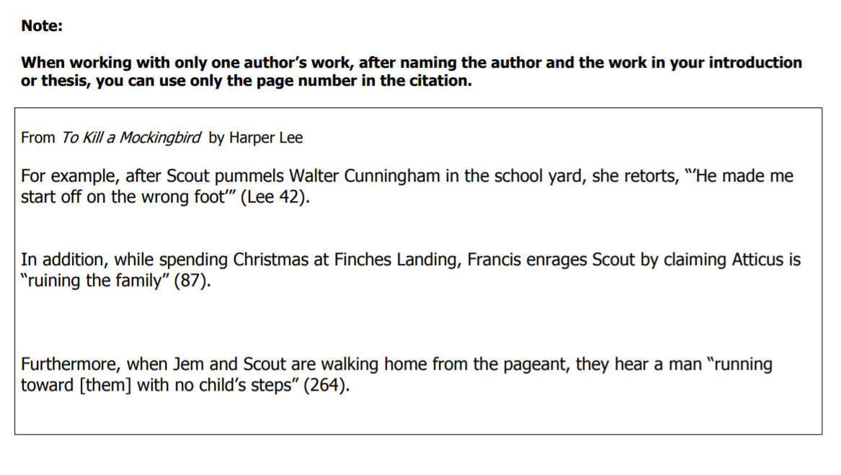

Slide 6
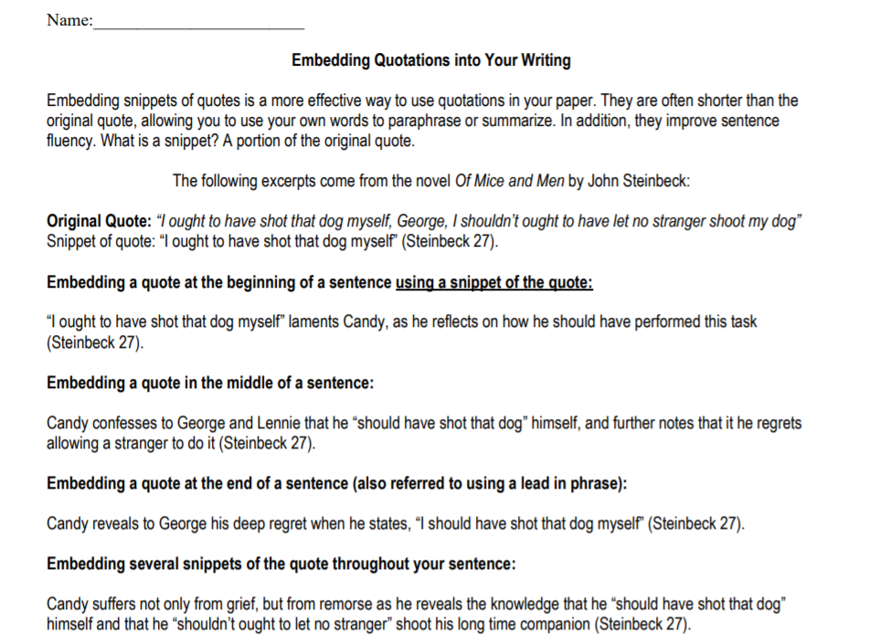

Slide 8
Embedding quotes
Four types on the handout:
Beginning
Middle
End
Throughout
A snippet: a portion of the original quote
Example#1:
“‘S’pose Curley jumps a big guy an’ licks him’” declares George about Curley’s insecurity and need for respect and admiration (Steinbeck 27).

Slide 9
Assignment:

Slide 10
Wednesday-October 3rd
Make sure you have turned in the embedded quotations practice from yesterday.
On a piece of paper, define the following terms.
1. Simple Sentence 4. Fragment
2. Compound Sentence 5. Run-on
3. Complex Sentence 6. Comma Splice
Group Activity-Sentence Variety/Grammar Review

Slide 11
Simple Sentences
A simple sentence is a sentence with one independent clause. Let's look at an example: I love simple sentences.
But look at this: Being an English teacher with a penchant for syntactical complexity, I love simple sentences.
(Being an English teacher with a penchant for syntactical complexity" is a participial phrase. "With a penchant" and "for syntactical complexity" are prepositional phrases.)

Slide 12
Compound Sentences
A compound sentence contains two or more independent clauses.
Connect with ,FANBOYS OR ; Example: I love discussing grammar, but my students love the beach.

Slide 13
Complex Sentences
A complex sentence is a sentence that contains one independent clause and one or more dependent clauses. Example: Because life is complex, we need complex sentences. (The independent clause is italicized.)

Slide 14
Compound-Complex Sentences
A compound-complex sentence contains two or more independent clauses and one or more dependent clauses. Example: Because I am an English teacher, some people expect me to speak perfectly, and other people expect me to write perfectly.

Slide 15
Common Sentence Errors
Fragment: a group of words that begins with a capital letter and ends with a period, question mark, or exclamation point but is grammatically incomplete
ex. After I saw the movie.
Comma Splice: occurs in a sentence when an author inserts a comma incorrectly between two main (independent) clauses to separate them
ex. I love cheese, it is so delicious
Run on: combination of two or more independent clauses, joined together without a conjunction or punctuation mark
ex. The students threw food in the lunchroom they got ISS for one day.

Slide 16
The Great Gatsby Passage chapter 7 Embedding quotations (TLQ)
Characterize the following characters & use the TWO types of embedding quotes
Nick Carraway
Jay Gatsby
Tom Buchanan
Daisy Buchanan
Remember to include the citation for each quote (Fitzgerald 137)
Use notebook paper and turn in

Slide 17
Example with bracket
Notice the punctuation:
Tom rebukes Gatsby by saying that “‘I always come back, and in my heart I love her [Daisy] all the time’” (Fitzgerald 127).
“‘I’ve got to tell you, old sport [Tom]’” says Gatsby, as he prepares to reveal that Daisy never loved him (Fitzgerald 127).

Slide 18
Thursday-October 4th
Greyhound News: www.GreyhoundNews.net
Do Now: Get rid of the gobbledygook!
A thesaurus wielding student has tried to disguise the following famous sayings in an attempt to avoid plagiarism. Can you translate them into their original form?
1. He who expresses merriment subsequent to everyone else expresses merriment of most superior quality.
2. Pulchritude is not evinced below the dermal surface.
3. Exclusive dedication to necessitous chores without interlude of hedonist diversion renders John an unresponsive fellow

Slide 19
Steps You Can Take to Avoid Wordiness
Eliminate unnecessary words that repeat the meaning
Ex. That material is too coarse in texture. “Coarse” is only a texture, at least when we speak of material.
Correction: That material is too coarse.
Ex. Each and every student voted to strike in protest.
Correction: Each student voted to strike.

Slide 20
Steps You Can Take to Avoid Wordiness
Simplify wordy expressions and eliminate passive voice. Ex. Madame Curie was a person who had a scientist’s curiosity.
Correction: Madame Curie had a scientist’s curiosity.
Eliminate unnecessary words “there” and “it.” Ex. There are many repairs to be made on that house.
Correction: Many repairs need to be made on that house.

Slide 21
Eliminate Passive Voice
The beautiful gown was worn by the homecoming queen.
This is passive voice because the object of the verb is being used as the subject of the sentence.
How do you eliminate it?
Flip the sentence to make sure the subject is DOING the action.
The homecoming queen wore the beautiful gown to the dance.
Get rid of BE verbs(am, is, are, was, were, be, being, been)

Slide 22
Thursday-October 4th
Complete Wordiness and Gobbledygook exercises-be ready to check answers in 20 minutes
Read directions and examples carefully☺
Get out a correcting pen! Answers may vary slightly. Not sure if it is right? Ask!

Slide 23
Answers to Wordiness Exercises Exercise A
Students use this room for studying.
Because some of the guests have not yet arrived, we will delay the meeting until 7:30 p.m.
Mr. Wishywashy decided to redecorate his office.
Traffic made us late for the meeting.
She studies hard to make good grades.

Slide 24
Answers to Wordiness Exercises Exercise B
Michael Jordan is probably the best professional basketball player.
Middle-income people must save all year for a one-week vacation.
Canned soup was suspected of causing botulism, a severe food poisoning.
Oops!
The Orioles will probably win the pennant.
No change needed; “It” refers to the school year.

Slide 25
Answers to Wordiness Exercises Exercise B
The team has so many new players this year that they are hard to recognize.
No change needed; “It” refers to the game.
She is easy to like because she is such a nice person.
No change needed; “It” refers to Pope High School.

Slide 26
Answers to Wordiness Exercises Exercise C
The house needs many repairs.
No change needed.
No change needed.
At least six other men could do this job better.
No change needed.

Slide 27
Friday-October 5th
Check answers to Wordiness/Gobbledygook exercises
Revision “Quiz”
1. Complete 1-20 on Zip Grade. PLEASE do not write on quiz☺
2. Use Essay to make 6 separate corrections. You must use 6 DIFFERENT SENTENCES!
3. This is NOT a group/partner activity. This is to see if YOU can make
revisions. Label the error=1 point
Original sentence copied from essay=1 point
Correction=worth up to 3 points(quality counts)

