Slide 1
American Lit. Week 2
August 6th-10th

Slide 2
Monday- DO NOW After you put your cell phone away, define theme on your own sheet of paper. DO LATER Read/ Study for Summer reading) - Study questions are optional, but are good to ensure comprehension. Our first parallel novel will be The Great Gatsby- have a copy in 2 weeks. Join remind & vocab.com- new list posted- practice due on 8/16. Hopefully your brought a folder today. :)

Slide 3
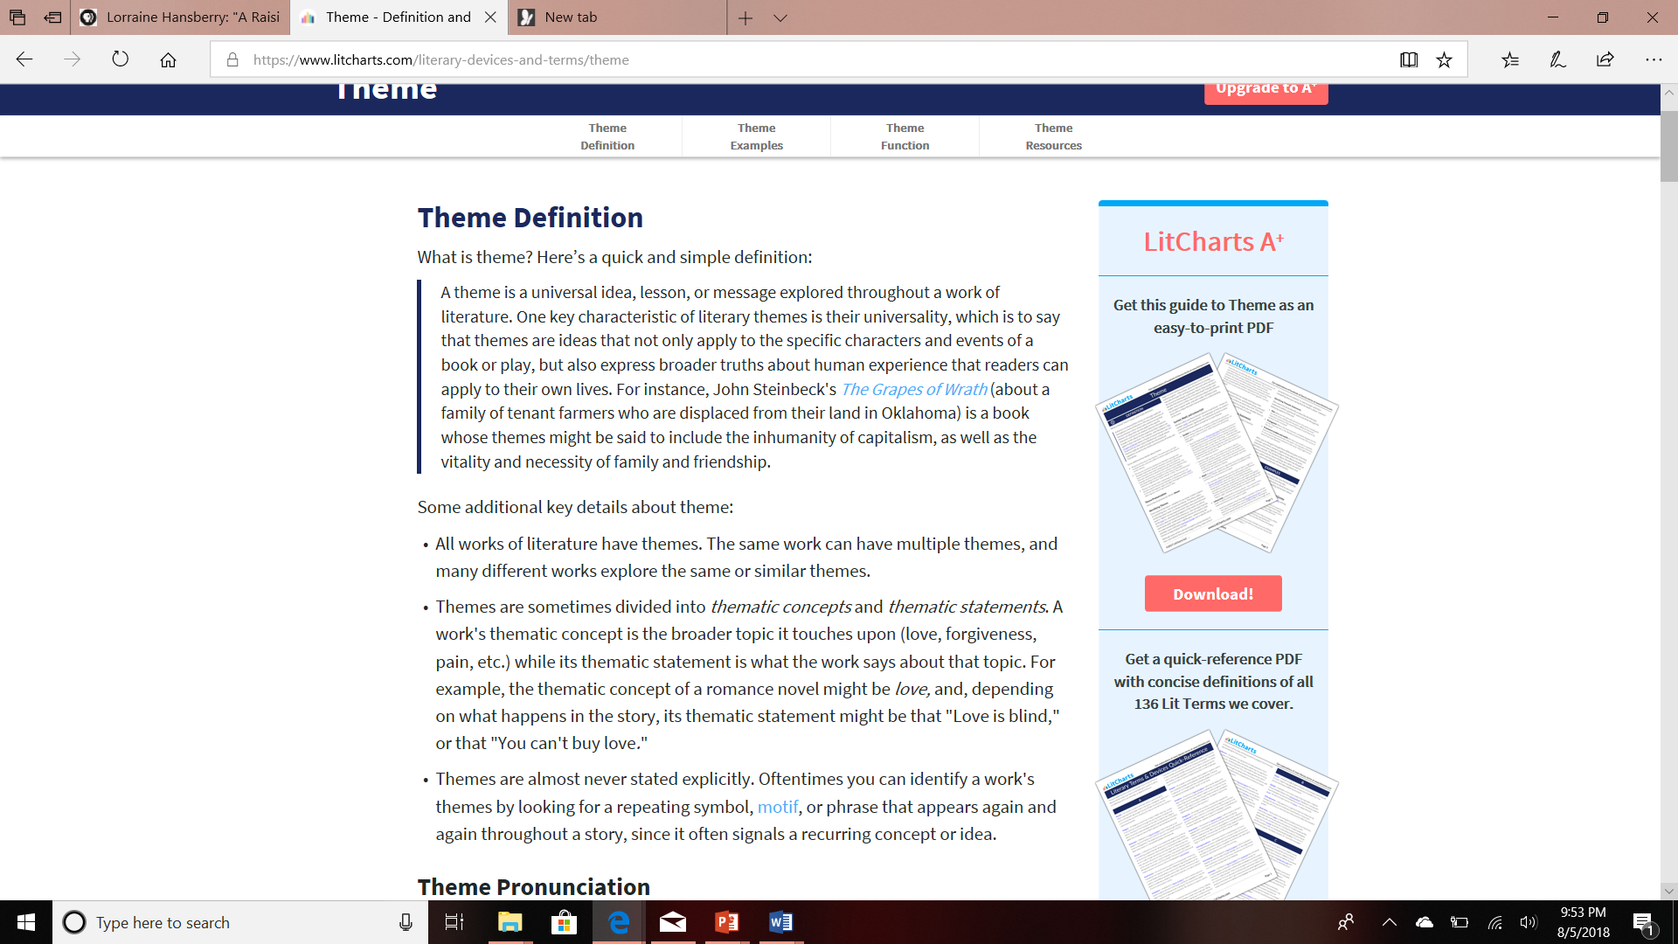

Slide 4
Work with your table to complete the following.
STEP 1—Theme Work
-Review each of the quotes from A Raisin in the Sun in your envelope.
-Decide as a group what ONE theme/theme topic is present in these quotes.
-Choose the most POWERFUL quotation to represent this theme/theme topic.
STEP 2—Create a Wall Poster using the instructions on the envelope.
Make sure all group members’ names are on the back☺

Slide 5
Carousel-Hang poster on the wall.
Travel with your group to view your classmates’ posters.
Record the theme identified by each group(use the sheet of paper that you used to define theme).
Once you have seen all the posters, circle the theme that you feel is the strongest or most prevalent throughout the play. Explain your choice at the bottom using a complete sentence.
Go back to your table when finished, so we can discuss.

Slide 6
Tuesday
Put your cell phone away and get out your work from yesterday.
Have someone from your group get your poster from the table!
Finish poster and discussion of theme.
Turn in poster and individual work.
Carefully tear along the perforations to remove Unit 1 out of the workbook (1-104)
Put it in your paper folder
Write your name on the SPINE of the workbook and the folder (permanent markers on shelf at front)
Keep paper folder with Unit 1
Return the book to the shelf at the back of the room!

Slide 7
Learning Target: Practice Exemplification by inferring John McCain’s definition of “patriot”
Exemplification - define by example
Read “About the Author” p. 6
List 3 interesting facts about McCain
Read “Veterans Day: Never Forget Their Duty”
Underline phrases that exemplify the author’s definition of patriot
Circle unknown words & phrases
Answer question 1-3 & “Check Your Understanding” p.8
Compare your notes with your table

Slide 8
Wednesday-August 8th
DO NOW After you put your cell phone away, make sure you have answered the questions on p.8 in your unit 1 folder.
1st period-Please answer questions #2 and 3 as well
2nd period-You should have completed this for homework.
4th period-We need to catch up to the other classes. Please start reading on p. 6, so
we can discuss. DO LATER Read/ Study for Summer reading) - Study questions are optional, but are good to ensure comprehension. Our first parallel novel will be The Great Gatsby- have a copy in 2 weeks. Join remind & vocab.com- new list posted- practice due on 8/16.

Slide 9
Wednesday-August 8th
Vision Board Assignment (Your American Dream) Due August 13 50 pts in Formative
A vision board is “a tool used to help clarify, concentrate and maintain focus on a specific life goal. Literally, a vision board is any sort of board on which you display images that represent whatever you want to be, do or have in your life. Many professionals believe having a concrete representation of what you want increases the likelihood you will get there. For your vision board, you will collect text and images (10+) that speak to what you want to be true in your life, short term or long term. This may include, but is not limited to:
Character traits or values you want to embody
Places you want to visit
People you want to spend more time with
Academic goals (or any goals)
Health or fitness goals
Things that bring you joy
Things you want to learn
Things you want to own
These are just some examples- really ANYTHING that represents what you want for your life.

Slide 10
Wednesday-August 8th
Vision Board Assignment Due August 13 50 pts in Formative
On the back, attach a sheet of paper that includes an explanation of each entry on your board in complete sentences. If something is super personal, note “personal,” but include at least 10 goals that you feel comfortable explaining.
You may do this assignment digitally or manually (cut and paste using magazines, etc.)

Slide 11
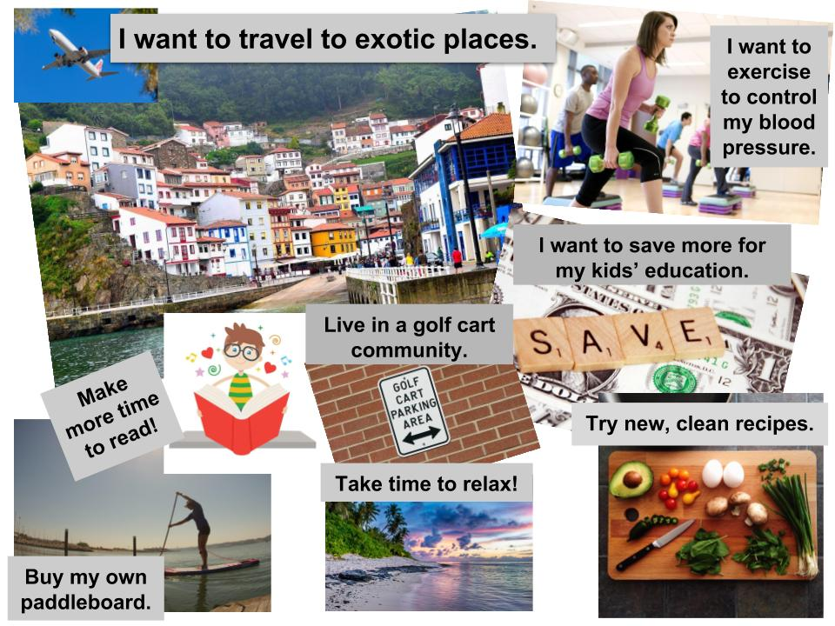

Slide 12
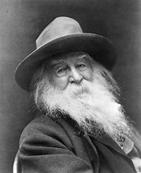
Thursday-August 9th
America’s Voices(p. 16-18)
Walt Whitman-Father of Free Verse(no consistent rhyme, meter, or
musical pattern; follows rhythm of natural speech
Walt Whitman Biography –write down 2 interesting facts
Famous for use of catalogs(lists), which he used to display
a wide range of people, situations, or objects in a poem
Praised by critics for his ability to create hundreds of images without repetition
Whitman's Voice (He has been dead for 126 years!)

Slide 13
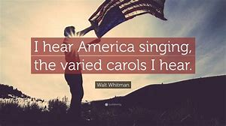
Thursday-August 9th
Read “I Hear America Singing”
Underline phrases that activate your senses (imagery)
Highlight words that indicate the attitude of the author (tone)
Circle unknown words and phrases
Answer question #1 following the poem

Slide 14
Thursday-August 9th
Langston Hughes(1902-1967)-wanted to tell the
stories of his people to reflect their actual culture
Langston Hughes Crash Course –write down three
interesting facts
Harlem Renaissance-an intellectual, social, and artistic explosion that took place in Harlem, New York(1920s)
Different from predecessors because he directed his poetry to the people he was writing about-used accessible language

Slide 15
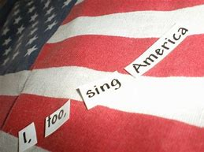
Thursday-August 9th and Friday-August 10th
Sit at the desk with your CELL PHONE POCKET #
Read “I, Too, Sing America”
Underline phrases that activate your senses (imagery)
Highlight words that indicate the attitude of the author (tone)
Circle unknown words and phrases
Answer question 4 on page 18

Slide 16
August 10th-Friday
We Sing America Assignment-Work today and Monday during class(DUE ON TUESDAY)
Don’t forget!
Vision board due Monday-remember to write explanation on the back!
ARITS vocab practice due Thursday @ 8:00 AM
ARITS vocab assessment on Friday

